Slide 1
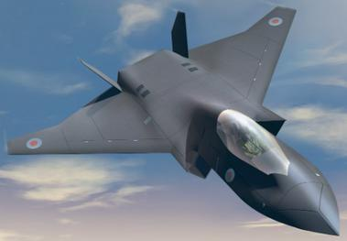
BINDT Aerospace Workshop - April 8th 2019 Materials for the Future Fighter and the challenges this brings for NDT Kevin Pickup – Lead Technologist – Product Verification BAE Systems Air

Slide 2
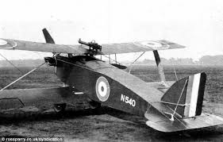
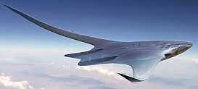
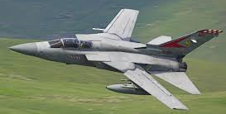
INTRODUCTION Aircraft Through the Ages
Over the last century aircraft have changed significantly, in both the materials we use to make them and the way we use the materials in the structure, but WHY?
Improved Strength - increased flight envelope and capability (more manoeuvrable)
Improved life cycle (fatigue)
Survivability & reparability from Battle damage
Weight saving – performance enabler
Optimised Aircraft Dynamics (aero elasticity & morphing structure)
Available materials has improved
Early Wooden Fighter
Concept Future Fighter
Tornado ADV

Slide 3
INTRODUCTION DRIVERS FOR CHANGE
FLEXIBLE
Re-configurable
ADAPTABLE
Environment& Efficiency
AFFORDABLE
Low Observability
QUALIFICATION TIME SPAN
Lead Time to Market

Slide 4
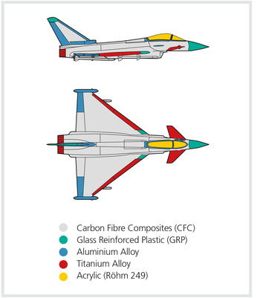
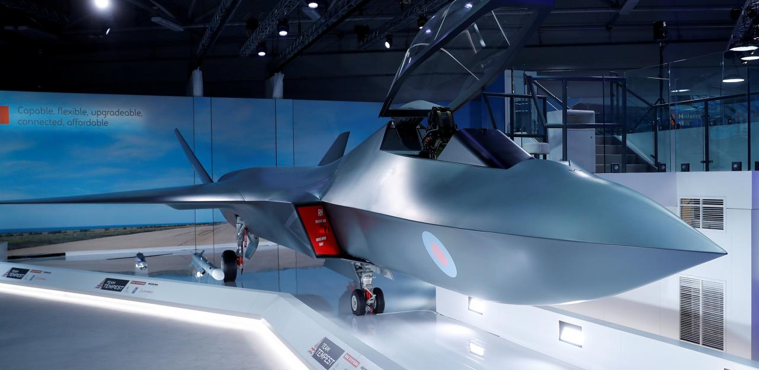
CURRENT AIRCRAFT Materials Make Up
Bae Hawk
100% Metallic
Future Fighter
? ? ?
Eurofighter Typhoon
Composite Skins
Metallic Frames

Slide 5
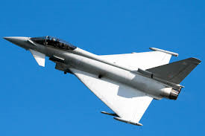
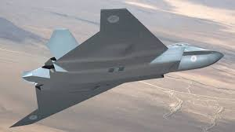
CURRENT AIRCRAFT ASSEMBLY PROGRESSION
Bonded Composites
Novel Fasteners
EB Welds
Diffusion Bonding
Co-Bonded Assemblies
????
Conventional Welding
Rivets - thousands of them!

Slide 6
FUTURE FIGHTER DETAIL & ASSEMBLY MANUFACTURE
3D Composites
Z stitching
RTM & LRI
Powder HIP
Paste Adhesive Bonded Primary Structure
Fibre Reinforced FDM/Plastics
Thermoplastics
AFP Toe Steering
Friction Stir Welding
Linear & Spot
Friction Stir Welding
Metal Matrix Composites
Hybrid & Dissimilar Composites Materials
WAAM

Slide 7
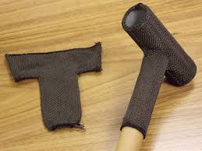
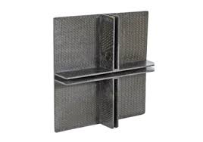
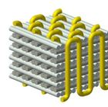
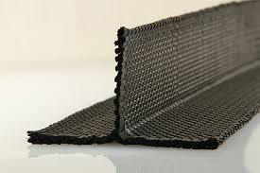
FUTURE MATERIALS 3D COMPOSITES – Raw Material form
The more complex the preforms become (tailored strength), the more critical to the structure.
Therefore verification of the weave pattern may be required prior to consumption
XCT required to define fibre orientation and path
Large parts and undesired aspect ratio may hinder required resolution in XCT

Slide 8
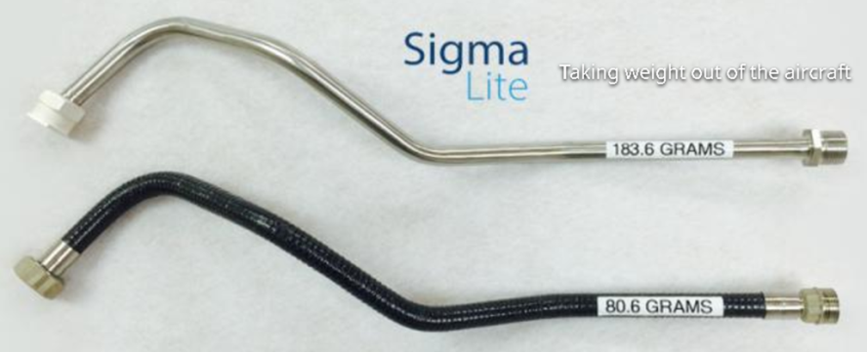
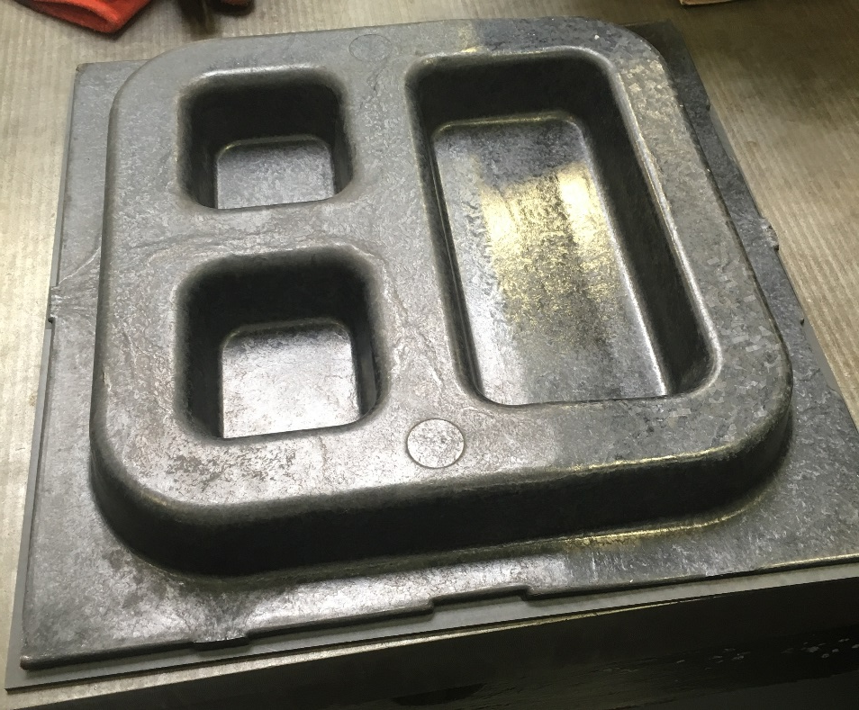
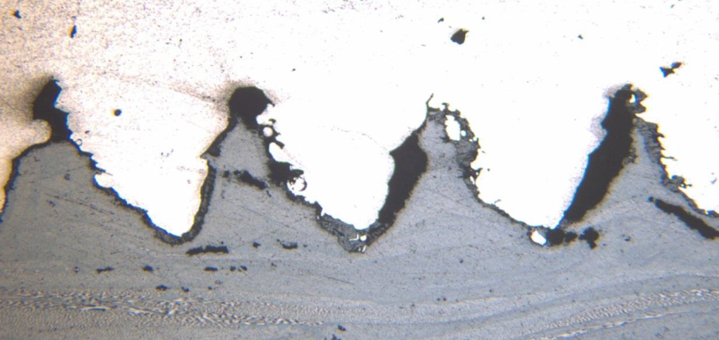
FUTURE MATERIALS THERMOPLASTICS
Thermoplastics have greater Durability and offer greater repair options and different joining options such as:
Welding – both butt/splice joints and lap joints
Tufting – mechanical and Z-Stitching
Microwave curing
They also offer greater forming options:
Hot Press forming – short & long fibre
Pipe bending
Thermoplastic fibre wound pipes
Short fibre PAEK to Ti 6Al4V mechanical bonding/Tufting
Short Fibre-PAEK moulded door assembly

Slide 9
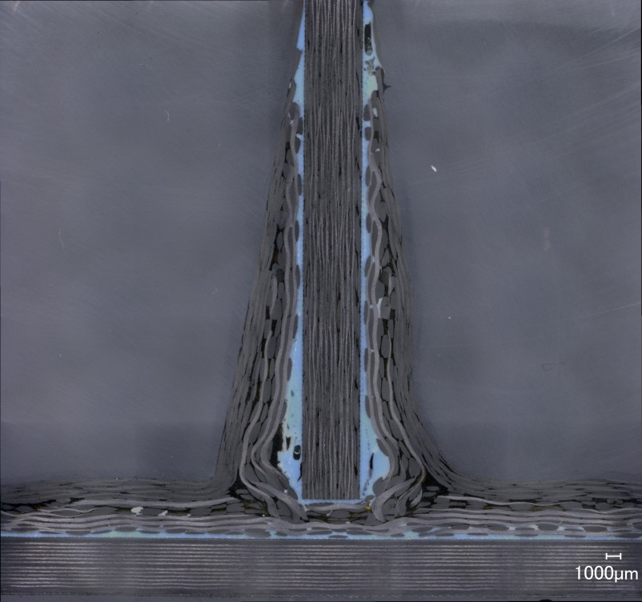
FUTURE ASSEMBLY BONDED JOINTS
Paste adhesive and flexible preform geometry
OML Control
Fastener-less Assembly
Less tooling required
Thinner Skins
Simpler detail part geometry
CHALLENGES:
Wet Assembly – messy!
Through laminate bondline and cleat assessment
Noisy materials
Low temp cured paste adhesive Pi preform/cleat stiffener/rib
BUT WHAT ABOUT THE KISSING BOND!

Slide 10
FUTURE ASSEMBLY KISSING BOND

Slide 11
NDT CHALLENGES Modern Materials & Assembly Methods
QUESTIONS?
&
THANK YOU

